Slide 1
Trauma Informed Care
2018
Jeri Gue

Slide 2
First and Foremost!
In the unlikely event of a sudden change in cabin pressure, oxygen compartments will automatically open in the panel above your seat.
Please fasten your own oxygen mask before offering assistance to others.
http://www.airlineannouncement.com/
Notes:
BTW, did you see that the airline attendant on the Southwest Airlines flight where the blade flew off—said that NO ONE was using their air mask properly. There was even a photo of a lot of passengers with the cup over only their mouths, not their noses. (Could be a metaphor that we all have some self-care challenges to overcome!)

Slide 4
Other Ways to Manage Stress
Maintain a work/life balance
Eat Healthy
Exercise
Maintain a good support system
Don’t be afraid to feel emotions
Never be afraid to laugh!
https://www.dfps.state.tx.us/Training/Trauma_Informed_Care/page02.asp

Slide 5
Questions to Address Today
What is Trauma?
What is Trauma Informed Care?
What does this mean for me as a service provider?

Slide 6
Examples of Trauma
123rf.com
Notes:
Physical Abuse
Living in a house with a person with mental illness and/or addiction
Loss of Relationships
Divorce
Foster Care
Sexual Abuse
Neglect
Domestic Violence
Moves
Death of a Loved One
Natural Disasters

Slide 7
What is Trauma?
Trauma
events that are experienced as physically, emotionally, or socially harmful and threatening and negatively impact development, health, and wellbeing
Adverse Childhood Experiences (ACES)
events that can overwhelm a child’s (person’s) capacity to cope and negatively impact development, health, and wellbeing
PTSD
a mental health disorder with a specific set of symptoms that can develop after exposure to a traumatic event
Trauma Informed Care, Aileen Fink, PhD., 9/23/16
Notes:
In the second bullet and elsewhere (slide #17, ‘youth”—could be adults too) the content references children or youth, which of course is the focus of the ACE Study. But your presentation doesn’t need to be restricted to kids, and you may want to point out that the phenomenon is equally relevant to adults who have traumatic experiences.

Slide 8
Spectrum of Trauma:
Acute Trauma: A single time limited event
Chronic Trauma: Multiple traumatic exposures and/or events over extended periods of time
Complex Trauma: Experiences of multiple traumatic events and the impact of exposure to these events (often occurring within the care giving system)
Secondary/Vicarious Trauma: Exposure to the trauma of others by providers, family members, partners or friends in close contact with the traumatized individual
Compassion Stress: the stress of helping or wanting to help a trauma survivor
Toxic Stress: Adverse experiences that lead to strong, frequent, or prolonged activation of the body’s stress response system
Trauma and Resilience: An Adolescent Provider Toolkit;
Adolescent Health Working Group 2013
traumainformedoregon.org
Notes:
You have a few slides on stress—you might want to start out clarifying that there are three general categories of stress:
--positive (getting married, starting a new job, moving into a new house)
--tolerable: normal stressors that are challenging but manageable (balancing home and work, managing a tough assignment, resolving a relationship dispute, etc.)
--toxic: as you have defined it above—
I’ve also heard of compassion fatigue—it may be the same thing as compassion stress, but I like the term because it is relevant to our works, all of whom we encourage to be compassionate despite often being overworked and undercompensated!

Slide 9
The Three “E’s” of Trauma
Event(s)
Direct or indirect exposure to an event, series of events, or circumstances
Experience
Event is experienced as threatening (physical, psychological, emotional, social), and creates a sense of helplessness, intense emotional pain and distress
Effects
Exposure overwhelms the individual’s capacity to cope and has lasting impacts on functioning (physically, psychologically, emotionally, socially)
Trauma Informed Care, Aileen Fink, PhD., 9/23/16

Slide 10
How Do We Know Someone Has Experienced Trauma?
Assume everyone has experienced trauma!!!!!

Slide 11
Adverse Childhood Experiences (ACES) Study
17, 337 Adults were surveyed between 1995-1997
Asked 10 questions about childhood exposure to
Abuse (physical, sexual, emotional)
Neglect (physical, emotional)
Household dysfunction (divorce/separation, domestic violence, household substance abuse, household mental illness, criminal behavior of household member)
Tracked health outcomes
Kaiser Permanente

Slide 12
ACE Survey Findings
ACEs have a dose-response relationship with many health problems
ACE Survey

Slide 13
Children Grow up
It is important to keep in mind that traumatized children may become traumatized adults
When childhood trauma is not resolved, individuals may continue to live in a state of fear and helplessness. If a child does not receive successful intervention for trauma, they are more susceptible to long-term effects (as adults).
Prolonged (toxic) Stress can become trauma
https://www.dfps.state.tx.us/Training/Trauma_Informed_Care/page02.asp

Slide 14
Trauma vs. Stress
Trauma is a sudden event that dramatically explodes into our lives and changes the way we perceive the world. A traumatic event is often life-threatening. Examples of traumatic events include terror attacks, natural disasters, abuse, etc.
Stress - is a reaction to less dramatic and often daily events that are perceived as threatening such as a job interview, deadlines, finances, or worries related to an ongoing security situation.
Positive
Tolerable
Toxic
traumaweb.org
Notes:
Three general categories of stress:
--positive (getting married, starting a new job, moving into a new house)
--tolerable: normal stressors that are challenging but manageable (balancing home and work, managing a tough assignment, resolving a relationship dispute, etc.)
--toxic: as you have defined it above—
I’ve also heard of compassion fatigue—it may be the same thing as compassion stress, but I like the term because it is relevant to our works, all of whom we encourage to be compassionate despite often being overworked and undercompensated!

Slide 15
Good Stress / Bad Stress
Stress (factors other than trauma) is a normal part of life.
Stress activates the Stress Response System
Stress becomes toxic when this system is activated for prolonged periods of time
Toxic stress can become traumatic stress
Notes:
I always emphasize that the stress response is adaptive—it is what allowed our ancestors to survive and it is what allows us to survive/thrive. Without a normal stress response, for example, we wouldn’t be alarmed at the truck coming down the road at us!
Most of the time we use toxic stress and traumatic stress interchangeably, the main difference being that toxic stress may be caused by factors other than trauma (working too hard without satisfaction or praise, working for a difficult supervisor, living next to a terrible neighbor), whereas traumatic stress is, of course, related to traumatic experiences.

Slide 16
Toxic Stress (and Trauma) Causes the Stress Response System to Remain on High Alert
High alert is like an alarm going off in your head
It is hard to concentrate, listen, pay attention, respond appropriately or learn when the alarm is ringing
Ordinary events and situations become escalated when the Stress Response System is on High Alert
Reactions/responses become escalated
The amygdala is in control, not the frontal cortex
Others, however, may shut down and become “functionally paralyzed.”
Trauma Informed Care, Aileen Fink, PhD., 9/23/16
Notes:
Ironically, the reactions may also be too subdued—think of someone so traumatized they are functionally paralyzed, frozen—overwhelmed by a current traumatic situation and/or beaten down over time by the load of cumulative trauma. (People pay more attention to the former—the squeaky wheel phenomenon.)
For your workers, some of the most relevant effects of trauma are the least dramatic, but often the most frustrating: memory and learning problems, emotional self-regulation and interpersonal relationship issues, especially with regard to TRUST. Remember that safety is the number one challenge for traumatized people, and often that means people are no longer seen as safe, or trustworthy. In this context, they may be testing your workers to see if they ‘say what they mean and mean what they say—” no empty promises, plenty of follow through.

Slide 17
Response to Trauma
A response to trauma may involve changes to behavior, social and emotional functioning, and/or physical health and wellbeing
These changes may be short or long term
Age and developmental functioning
Type of traumatic event
Intensity and duration of the event
Prior exposure – dose response –to traumatic events
And are dependent upon the level of support received

Slide 18
Trauma Triggers:
Activate the “survival brain,” causing individuals to react as though a “there and then” experience (previous traumatic event) is happening “here and now” (in current reality).
Common Triggers include:
Unpredictability (e.g. a fire drill)
Sensory overload
Feeling vulnerable or frustrated
Confrontation
Environmental
Sensory
Trauma and Resilience: An Adolescent Provider Toolkit;
Adolescent Health Working Group 2013
Notes:
Common triggers are also things that may happen in this work context and that workers should be alert to: face or other characteristics remind them of their abuser, smell or sound in the environment similar to a noxious experience, the location or topic being discussed is a reminder. The goal is for the worker to a) not take it personally and b) if it is extreme or frequent, ask the client if there is something that reminds them of a bad experience. (They may or may not be able to recall it, but just having that conversation is a way to build trust.)

Slide 19
What Can We Do?
What can we do as service providers to avoid triggering and/or adding to an individual’s trauma?
First do no harm.
Hippocratic Oath

Slide 20
What is Trauma Informed Care?
TIC is a strengths-based framework that is grounded in an understanding of and responsiveness to the impact of trauma … that emphasizes physical, psychological, and emotional safety for both providers and survivors … and creates opportunities for survivors to rebuild a sense of control and empowerment.
Instead of asking, “What is wrong with this person?” Ask instead, “What has happened to this person?”
https://www.dfps.state.tx.us/Training/Trauma_Informed_Care/page02.asp
Hopper, Bassuk & Olivet 2010, pg.82

Slide 21
A Trauma System consists of:
a traumatized person who has difficulty regulating emotional states (and behavior)
and
a social environment and/or system of care that is not able to help the person to regulate these emotional states (and behaviors) (e.g. caregivers, school)
Joyce Dorado, Ph.D (2013) Child and Adolescent Services,
UCSF/SFGH (Saxe, 2006)
Notes:
This is really interesting—you are pointing out the interplay between our internal states and the organizations in which we work or where we are served. Great point. Maybe use the idea to point out that try as we might, we can’t always change the organizations, but we can always choose to change ourselves—how we react, how we respond to our clients.

Slide 22
A Trauma Informed Approach:
Recognizes that certain behaviors are related to traumatic experience
Shifts from a model that asks, “What is wrong with you?” to one that asks, “What happened to you?”
A new question emerges: “How can we shift our environment and practices to respond more effectively to your needs?”
Using Trauma Informed Strategies to De-Escalate Classroom Conflict,
Jenn Rader, James Morehouse Project, El Cerrito High School
Notes:
First bullet has an orphan ‘to’ at the end.
You may want to use the “4 Rs” that SAMHSA described in their guidance:
-Realize that trauma is common in the general population
-Recognize the extent of traumatic history in our service population
-Respond as appropriate to the dynamics and needs of trauma survivors in the specific service population
-Resist Re-traumatizing people: (As you say, First do no harm!) make service environments as pleasant and non stressful as feasible, engage people rather than telling them what to do, promise only what you know you can deliver, practice emotional self-management, etc.

Slide 23
So …..
are we all therapists and counselors in addition to our current jobs?????

Slide 24
No ……., but
what does this mean for me as a service provider?

Slide 25
Containment: What if someone self-discloses?
Ask yourself: “What would I say to a loved one?”
“I am really sorry this happened to you.”
“Is there a connection between what happened then and the problems you are facing now?”
Offer practical help: remove barriers, facilitate access to resources
If he/she gets emotional, don’t panic: normalize the reaction-”I get why that’s so upsetting.”
Redirect energy to productive activity: “Let’s see what we can do to move past this.”
Referrals to other providers as appropriate.

Slide 26
REMEMBER
Working in a trauma-informed system, individuals recognize that they personally are not immune to the impacts of behavioral health issues, stress, or trauma.
At the core of our ability to help others is the ability to help ourselves.

Slide 27
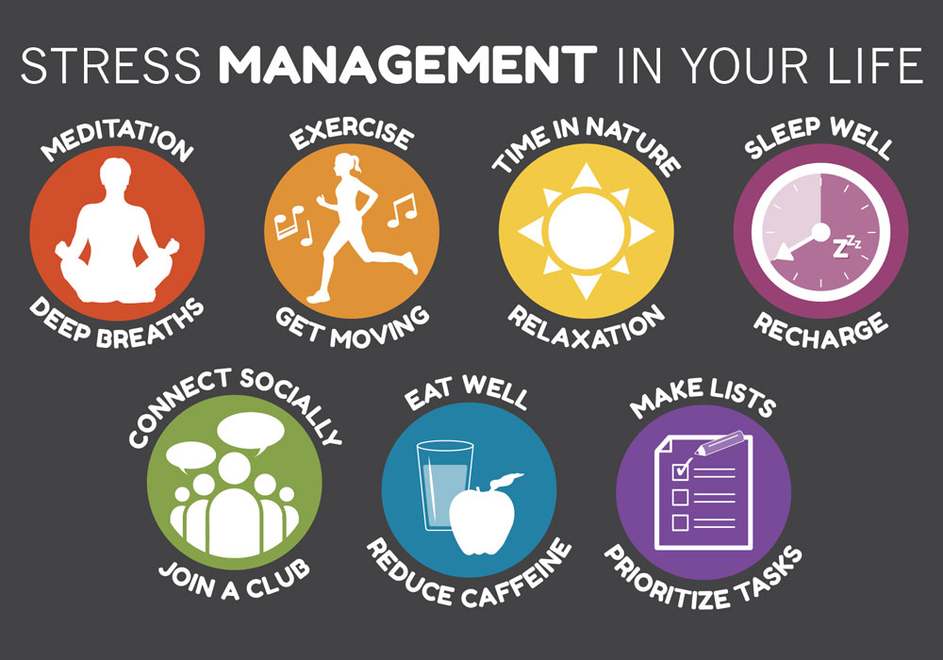

Slide 28
In the Workplace
Be mindful of your physical environment – add color, scents, sound, lighting (favorite piece of art, nature-inspired items, lavender air freshener, cheerful lamp)
Create a basket of go-to comfort items for all
Mandala coloring items https://mondaymandala.com/m
Meaningful poems or images
Random acts of kindness!
Team Spirit
Space for self-care
www.starr.org

Slide 29
As Clients Enter Our Workplace
Be respectful
Be patient
Be understanding that those you encounter may have trauma
Pleasant greetings go a long way!
Eye contact
Smile!
Assume everyone has experienced trauma
Notes:
With TIC we say “Assume the person has had traumatic experience—the data suggests most of us have had at least one! Plus, it doesn’t hurt to apply the principles of TIC—it can only help, even if they have not had trauma.
--I heard Renee’ Beamon say the other day: “Remember, this may be the worst day/week/month of that person’s life—act accordingly.
--Be trustworthy: “say what you mean and mean what you say.”—follow through on promises--

Slide 30
Prologue to ‘Invisible Man’
“I am an invisible man. I am invisible, understand, simply because people refuse to see me…It is as though I have been surrounded by mirrors of hard, distorting glass.
“To whom can I be responsible, and why should I be, when you refuse to see me?”
Ralph Ellison (1941) from Aran Watson,
“Healing the Hurt” Trauma Series, RYSE 2014

Slide 31
Takeaways
Trauma – any experience that can leave a person (student/parent/staff member) intensely threatened physically, emotionally, psychologically.
Trauma Informed Care – an approach to understand and provide a supportive environment for all persons within a service setting.
As service providers it is our responsibility to embrace the team philosophy of, “What has happened to this person?”

Slide 32
https://youtu.be/6BdW6tAb-5M

Slide 33
Thank You!
You do the best you can with what you know. When you know better, do better.
Maya Angelou

Slide 34
Resources
The ACE Study Website: http://www.acestudy.org/
ACE Online Questionnaire: https://www.npr.org/sections/health-shots/2015/03/02/387007941/take-the-ace-quiz-and-learn-what-it-does-and-doesnt-mean
ACE Info-graphic: http://vetoviolence.cdc.gov/apps/phl/resource_center_infographic.html
Delaware 211: www.delaware211.0rg
Directory of Human Services for Delaware: http://dhssdelaware.gov.dhss/
National Survey of Children’s Health 2011-12 Report:
http://www.childtrends.org/wp-content/uploads/2013/07/124_Adverse_Experiences.pdf
National Child Traumatic Stress Network: http://www.nctsn.org
University of California, Berkeley: Greater Good: http://greatergood.berkeley.edu/article/item/the_silent_epidemic_in_our_classrooms
Creating Sanctuary in Schools by Sandra Bloom: http://www.sanctuaryweb.com/PDFs_new/Bloom%20Sanctuary%20in%20the%20Classroom.pdf
Child Trauma Toolkit for Educators: http://rems.ed.gov/docs/NCTSN_ChildTraumaToolkitForEducators.pdf
Using Trauma Informed Strategies to De-Escalate Classroom Conflict:
http://www.schoolhealthcenters.org/wp-content/uploads/2014/03/Trauma-Informed-Strategies-to-
Deescalate-Classroom-Conflict.pdf
Managing Acting Out Behaviors:
http://ed-psy.Utah.edu/school/psych/_documents/grants/restraint/managing-acting-out-behaviors.pptx

